Slide 1
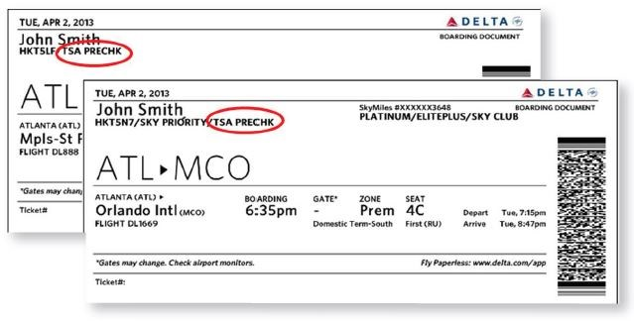
Findings and conclusions
ATL & MCO Passengers Number
PASSENGERS | JAN 2019 | JAN 2018 | DEC 2018 | DEC 2017
Atlanta Total | 8,064,004 | 7,708,129 | 8,642,487 | 8,062,075
Total Delta Passengers | 5,906,095 73,24% of total | 5,658,463 73,52% of total | 6,282,965 72,70 % of total | 5,775,565 71.64% of total
Orlando Total | 4,117,402 | 3,905,568 | 4,315,895 | 3,982,171
https://www.atl.com/business-information/statistics/
https://orlandoairports.net/about-us/#traffic-statistics

